Slide 1

BTECH 451
27th March, 2012
Presented By Vishal Naidu
An Introductory Seminar..
Tyre Pressure And Tread Depth Mobile Application

Slide 2

Presentation Overview
About the Company
Problem
The Mobile Application
Hope To Achieve

Slide 3
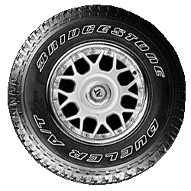
BRIDGESTONE
Bridgestone NZ Ltd was formed in September 1998, followed a merger between two world premier tyre companies: Bridgestone and Firestone.
Bridgestone Corporation is the worlds leading tyre manufacturer, supplying quality tyres for cars, trucks, aircrafts and others.
The aim of this project is to develop the capacity and performance of tyre information by a mobile application to deliver high quality tyre services in stores.
Supervisors – Philip Low And Candy He

Slide 4
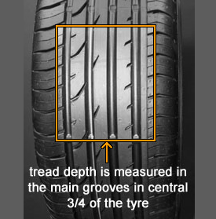
Problem?
Inspection of a vehicle requires a technician to fill out a Vehicle Inspection Report (VIR). Multiple forms would have to be filled if the technicians were inspecting multiple vehicles in a fleet.
Data like account name, date, registration number would have to be filled out multiple times for different forms like the VIR, VCR and job card. Data redundancy can cause a lot of problems, which includes data inconsistency and time.
Extracting data (Live Tyre Pressure readings) from Tyre Vigil where the server is located in Canada.

Slide 5
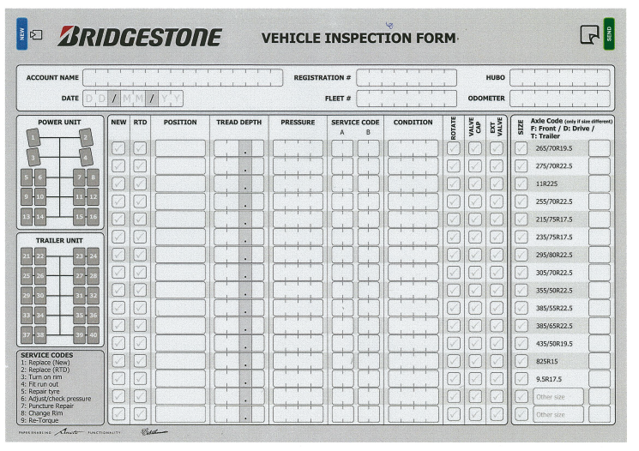
The Mobile Application
The goal is to build a mobile application that helps employees hired by Bridgestone with a digital possibility of a Vehicle Inspection Report. It is designed to reduce the redundancy of having the employees manually filling out each form and entering into the database.
The application should be able to display the latest tyre pressure reading, and allow the users to validate and update information (tyre pressure and tread depth)about the vehicle which would then be stored at the data warehouse where other instants could use that data (Scott’s App)

Slide 6
What Am I Doing?
Currently:
Future:
Induction to Bridgestone
Detailed walkthrough of Bridgestone’s Systems.
Learning about web services (WCF), SOAP and creating a simple SQL database query service with an interface
Refining the scope, functionality and constraints
Created an initial use case diagram
Attended Windows 8 camp
Create an interface for a side project to showcase our skills to our superiors.
Demonstrate use of software through diagrams, interfaces and programs.
Meeting the ‘fleeties’ on a field trip understanding the work flow process.
Documentation and Research (Problem and Opportunity, Feasibility Analysis, Costs)
Creating a web service from client and ser
Produce prototypes and get feedback.

Slide 7
What can I gain?
Working in a business environment with superiors and guidelines.
Experience business processes in action (SDLC).
Contacts in the industry.
Solve real life technical problems.
Will be using latest software like Microsoft Visio, Expression Blend 2011 and Visual Studio 2011 regularly.
Gaining experience with programming languages like SQL, C#, Java C, XML etc.

Slide 8
Questions ?

